Slide 1
Binary Classification of Sepsis Development Using LLM Technology
Sampath Martha, Nick Smith, Joseph Walker

Slide 2
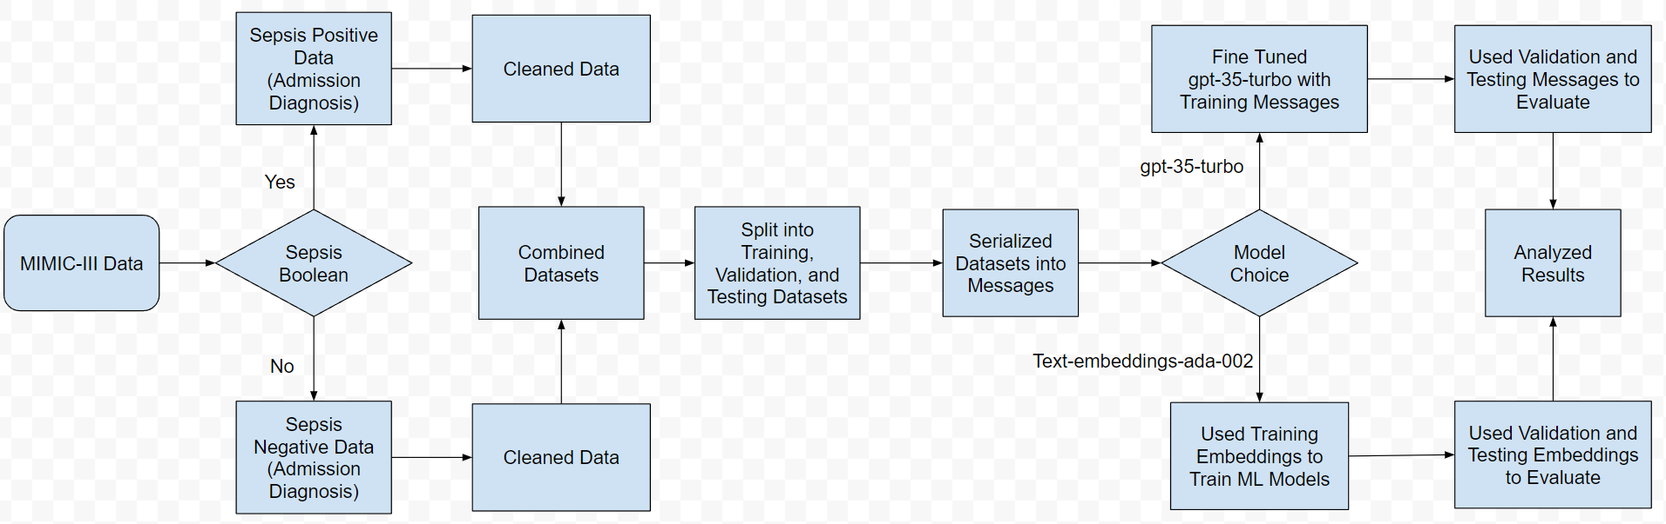
Introduction
The goal of this project is to detect sepsis in patients. We attempted two different approaches: fine tuning ‘gpt-35-turbo_0613’ and passing ‘text-embedding-ada-002’ embeddings to train ML models.
MIMIC-III data was parsed and used to create DataFrames used to train, test, and validate the models.
Features were selected based on the medical definition of sepsis (Sepsis-2) during the time of MIMIC-III data collection.
Lastly, we analyzed the performance of the models, and a screening tool used by nurses in the literature, to compare their effectiveness.

Slide 3
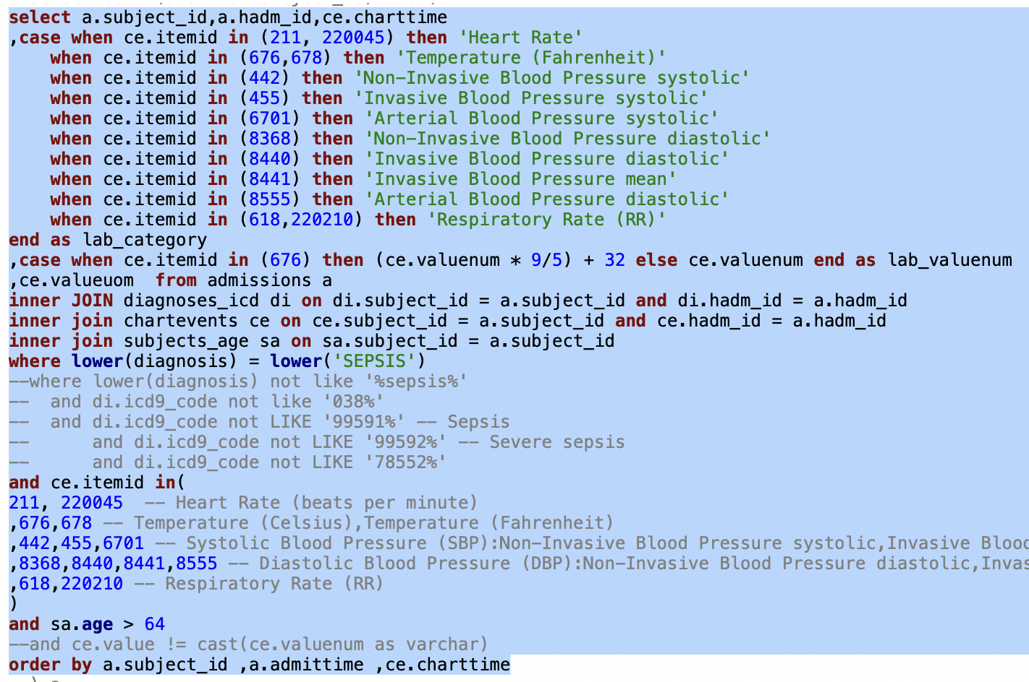
Methodology - Data Frames
Created two datasets from SQL queries: one for sepsis positive patients and one for sepsis negative.
Positive patients were selected based on the diagnosis at the time of admission.
Negative patients were confirmed to be sepsis negative throughout entire hospital admission lifecycle based on their icd9 codes that did not correspond to sepsis.
Identified initial target features that correspond to Sepsis-2 characterization: Heart Rate, Body Temperature, Blood Pressure, and Respiratory Rate
Feature data was taken from both chartevents and labevents tables.
Selected patients between ages 65 and 120 inclusively.

Slide 4
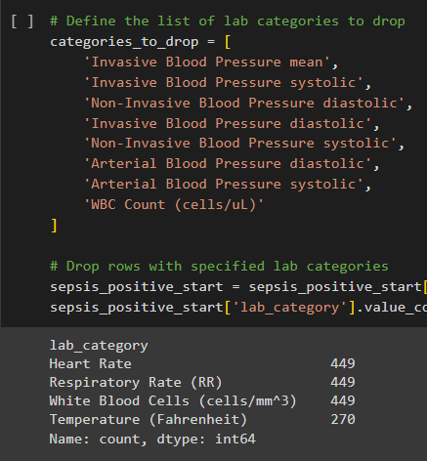
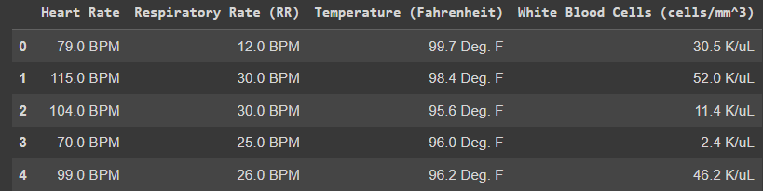
Methodology - Clean Data
Ran initial tests on LLM model with 7 features and determined that there were some of the features which are not required as per Sepsis 2 definition.
Further refined DataFrames, dropping extra columns and targeting features: Heart Rate, Respiratory Rate, Body Temperature, and White Blood Cells.
Removed any patients that had missing values in any of the target feature data to prevent unknown LLM behavior
Performed the data cleaning on both sepsis positive and sepsis negative datasets.
Considered only the feature values that were recorded within 24 hours of admission.
Confirmed positive patients had appropriate icd9 codes during stay; negative patients never had icd9 codes indicating sepsis during their stay.

Slide 5
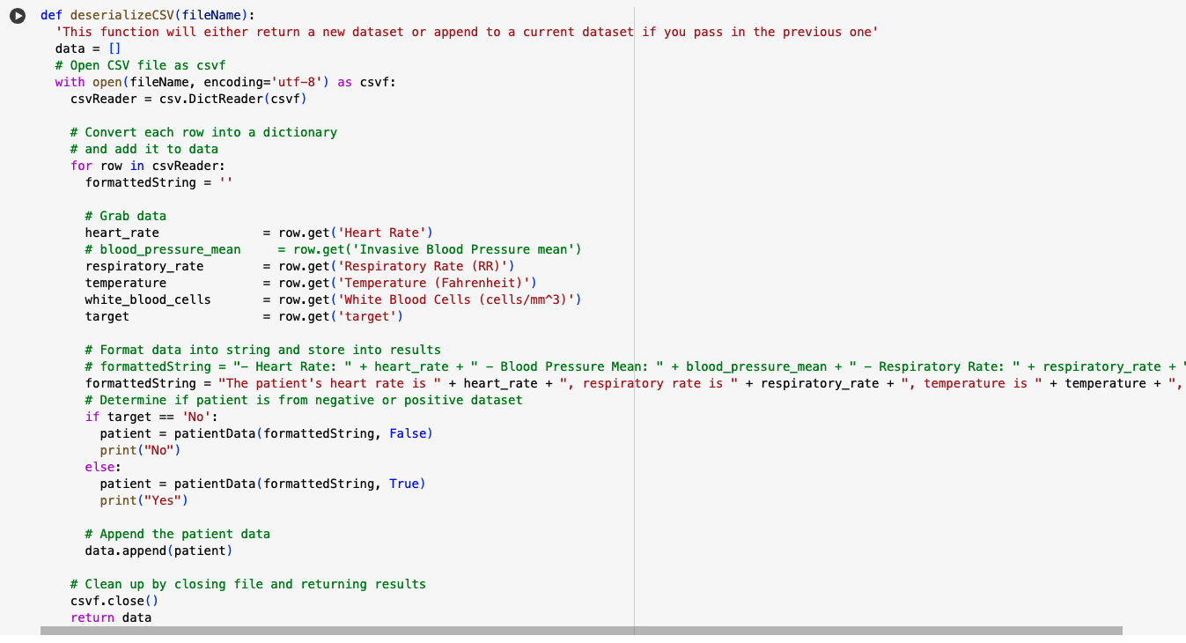
Methodology - Serialization
Datasets were combined and an extra column was created to label if the patient was sepsis positive or not.
Train, validate, and test sets were derived from complete data set. 70% for training, 15% for validation, 15% for testing.
Specific prompt was used on all algorithms for consistency
Does this patient most likely have sepsis? Reply only with a Yes or No as your answer.
Prompts were serialized into message formats as required for Fine tuned LLM and text-embeddings-ada models.

Slide 6
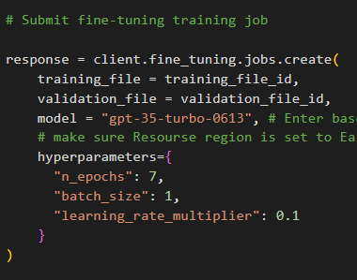
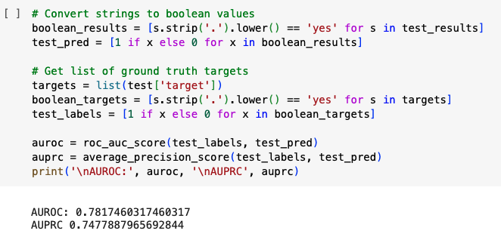
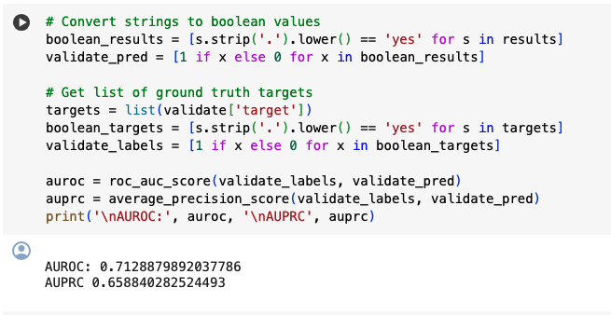
Methodology - Fine tuned LLM model
Training and validation data sets were supplied to train the gpt-35-turbo-0613 model
Hyperparameters were set for the fine tuning process
Fined tuned is applied on test and validation datasets to predict the sepsis
Observed both AUROC and AUPRC percentages are higher on the test dataset.

Slide 7
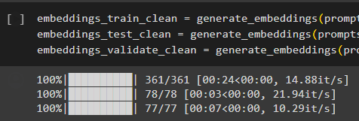
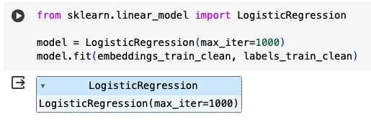
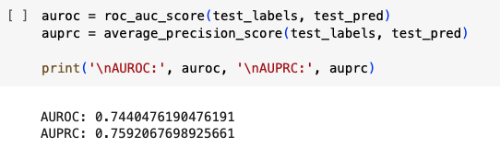
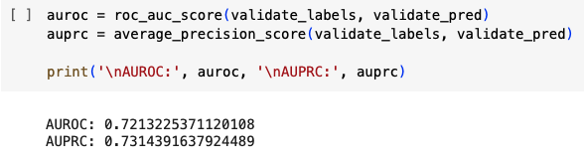
Methodology - ML models on text-embeddings-ada model
Sepsis detection prompts corresponding to training, test and validate dataset were sent to text-embeddings-ada-002 model.
Built a Logistic Regression classification model on the training embeddings received from LLM model.
Validate and test dataset embeddings applied on the classification model to predict the sepsis.
Later various other ML algorithms: Decision Tree Classifier, RandomForest, SVC, XGBoost were applied on training data set embeddings to check for a better model performance.
Logistic regressions and RandomForest performed best out of the ML classifiers attempted.

Slide 8
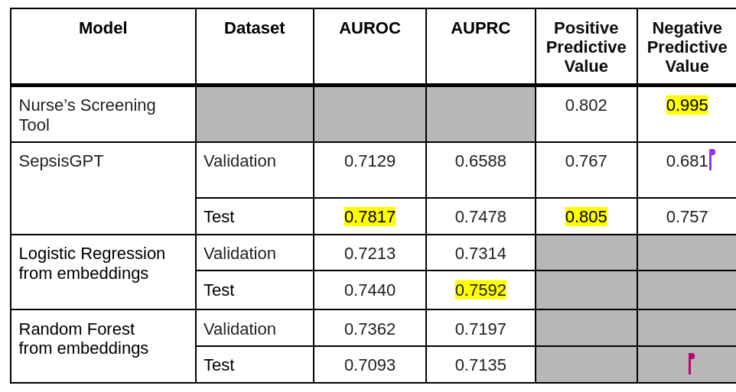
Results
From reviewing the results we can determine that the fine tuned SepsisGPT model performed the best among test dataset scores for AUROC, and the logistic regression algorithm performed the best for AUPRC scores on the test dataset
SepsisGPT seemed to have the least consistent performance based on validation compared to test values.
While all models seemed to underperform the nurse’s screening tool, the SepsisGPT did achieve comparable positive predictive value results.

Slide 9

Future Directions
Get baseline feature values for each patient at a healthy state to contrast for abnormalities in target features data.
The outcomes may be different if we were able to use more features based on both the Sepsis-3 and Sepsis-2 definitions.
Evaluate the model performance using data from patients of all ages.
Fine tune SepsisGPT experimenting with various hyperparameter values: lower learning rate, more epochs, etc.
Design the LLM model to predict the Sepsis disease progression based on the temporal data.

